Slide 1
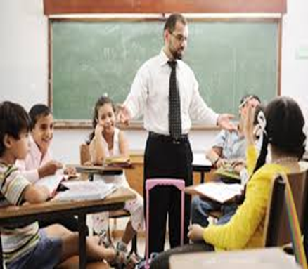
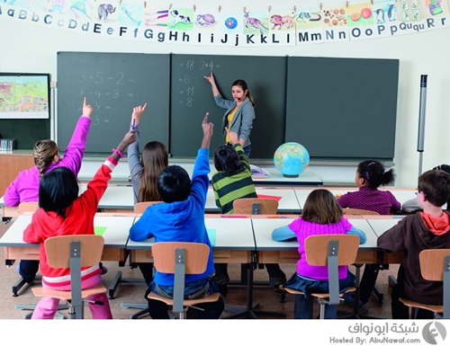
Language Policy and Education in Algeria:
A Sociolinguistic Interpretation
Presented by:
Ms. Hayat BAGUI Mrs. Meryem BABOU

Slide 2
INTRODUCTION
* The present paper aims fundamentally at highlighting the impact of diglossia on formal education in general and on teaching the Arabic course in particular. It examines language education policy in Algeria with focus on the medium of instruction. It endeavours at unveiling linguistic behaviour of Middle school teachers within an Arabic session where MSA must be used as the solely medium of instruction. It attempts to explore the reasons that stand behind Arabic language teachers’ switch towards a middle variety or AA.

Slide 3
Language Policy and Education
Education in the Pre-Colonial Era: Koranic schools (zawiya or madrasa),
Education during Colonialism: The French did their best to assimilate the French language and culture. The French language was, therefore, implemented as the only language of teaching at all levels whereas Arabic had been considered as an optional foreign language,
Education in Post-Colonial Era: The independent state has been characterized by a linguistic diversity. As a result of historical events, four varieties were present: Algerian Arabic, Modern Standard Arabic, Berber, and French. Therefore, it was necessary to set up a unified state with a single religion, a single language, and a single political party. Hence, Algerian authorities have undergone a set of interesting sociolinguistic reforms and continuous policies in order to recover their Arabic language in all sectors of life mainly, the educational sectors: primary, middle, secondary, as well as higher.

Slide 4
Anyway, Algerian authorities considered both varieties either AA or Berber as "impure" languages; comprising so much French words and "inappropriate" as well, never considered as national symbols of the state. Politically speaking, Berber is recognized as a national language but not as an official language (the official declaration was made on April, 10th 2002). Despite this recognition, Berbers are not satisfied with this situation because they seek equality between the status of Arabic and Tamazight. Additionally, the constitutional amendment in 2011 did not change any condition in the principles of the Algerian society. There was no more than a formal recognition of the language existence and no positive action has been undertaken in favour of Berber.
Modern Standard Arabic: the official language of education.
Real Classroom Situations
?

Slide 5
OBJECTIVES Of the Study
Based on the Revisited version (1991) of Ferguson’s classical diglossia, this research work relies fundamentally on identifying the different linguistic behaviours of Arabic language middle school teachers in the Arabic course, unveiling the social forces that motivate the teachers to select which code of their verbal repertoire to use.
The present research work includes, thus, a classification of the phenomenon in terms of ‘internal’ code switching which is of a diglossic nation, i.e., switching back and forth between the H and L varieties.

Slide 6
new intermediary variety ‘the middle variety’. On the light of Ferguson's terms (1970), variety situated somewhere midway between MSA and AA: ‘al-lugha al-wusta’.
Lughat al muthaqqafiin ‘language of intellectuals’ (Badawi, 1973)
Educated Spoken Arabic ‘ESA’ (Mitchell, 1978),

Slide 7
General Research Question
How do our middle school Arabic language teachers behave linguistically in classroom interaction? And what are the reasons that stand behind their linguistic behaviour?
Sub-Questions
1/ What form of Arabic is actually used in Tlemcen middle school classroom interaction?
2/ What are the reasons behind teachers’ use of a colloquial Arabic form (Algerian Arabic) and/or a middle variety?
3/ What are the attitudes of our Arabic language teachers as well as their pupils towards the use of Algerian Arabic and/or the middle variety?

Slide 8
Hypotheses
1/ Our Middle school Arabic language teachers tend to use three forms of Arabic: MSA, the middle variety, and sometimes AA solely in classroom interaction.
2/ A considerable number of teachers seem to use AA and/or the middle variety in a spontaneous way or according to the topic discussed while others even believe that the dialect may enhance pupils’ assimilation.
3/ There might be some negative attitudes towards using AA and/or the middle variety on the part of teachers while learners may display positive ones.

Slide 9
Mixed methods approach based on both quantitative and qualitative.
Research Design
Recording Observation
Interview
Questionnaire
Triangulation
Site of Research
Arabic Language
Middle Schools Teachers
Pupils:
Four Levels

Slide 10
Sampling and Stratification of Informants
Teachers’ Profile
Middle Schools | Males | Females | Less than 10 years teaching experience | More than 10 years teaching experience | Total
Habbak | 3 | 8 | 1 | 10 | 11
Tahar Hmaidia | 0 | 6 | 1 | 5 | 6
Dar E-Hadith | 1 | 3 | 3 | 1 | 4
Ben Zerdjeb | 0 | 4 | 3 | 1 | 4
Ibn Khaldoun | 2 | 3 | 1 | 4 | 5
Et-tammimi | 3 | 3 | 3 | 3 | 6
Moulay Idris | 0 | 5 | 4 | 1 | 5
Yaghmoracen | 3 | 4 | 2 | 5 | 7
Total | 11 | 37 | 18 | 30 | 48

Slide 11
Pupils’ Profile
Middle School | 1st Year | 2nd Year | 3rd Year | 4th Year | Total
Habbak | 30 | 30 | 30 | 30 | 120
Tahar Hmaidia | 30 | 30 | 30 | 30 | 120
Dar El-Hadith | 30 | 30 | 30 | 30 | 120
Total | 90 | 90 | 90 | 90 | 360

Slide 12
Results and Interpretation
Forms of Arabic Used in Classroom Interaction
12 Recordings
Dar-Hadith
Habbak
Hmaidia
MSA: reading texts,
Middle Variety ( a benti marakish thessi beli raki deyra khata2 fadih)
AA solely (lawla w talia 3lik)
Intra-sentential switching
Inter-sentential/ Tag switching

Slide 13
Reasons Affecting Teachers’ Linguistic Behaviour
Aware Vs Unaware Use of middle Variety and/or AA
Difficulty of the subjects | 7.36%
Pupils’ weak assimilation and understanding | 14.73%
Topic Discussed | 7.36%
Simplification of concepts or ideas | 13.68%
Clarification of ideas | 11.58%
Re-explaining the lecture | 6.84%
Pupils’ weak linguistic proficiency | 10.53%
Pupils’ punishment | 14.21%
Creating good and warm atmosphere in the class | 12.10%

Slide 14
Teachers’ Use of Middle Variety/ AA in the class is Topic Related

Slide 15
Teachers’ Use of Middle Variety/ AA in the class in Correlation to Pupils’ Assimilation Enhancement

Slide 16
Attitudes Towards The Use of the Midddle Variety and/ or AA
Teachers’ Attitudes towards Middle Variety Vs AA Use
Pupils’ Preferred Code as a Medium of Instruction

Slide 17
Conclusion
This empirical research work provided us with a closer picture about the various linguistic behaviours of Arabic language teachers in classroom interaction.
MSA is the programed variety (LP); yet, actual situations unveil that the middle variety was the prevailing variety in nearly all Arabic course classrooms (intra-sentential switching) + (Tag-switching).
Awareness Vs Unawareness ( Marked Vs Unmarked). Most cases of the switch are expressed spontaneously via ‘stress’ and ‘rising intonation’. When finding it is necessary to create a good and relax atmosphere, teachers showed a clear sense of awareness towards their linguistic behaviour.
The topic discussed stands out as a trigger that operates to influence teachers’ language of discourse. This kind of metaphorical switching is, therefore, determined by attitudes towards the codes and the associations allocated to these codes.

Slide 18
Middle variety seeks at facilitating the teaching and learning processes and enhancing pupils’ assimilation.
Pupils displayed positive attitudes toward AA and/or the middle variety whereas teachers showed some negative attitudes.
Teachers’ speech clearly showed inconsistency between their attitudes and their actual behaviour. Actual behaviour in the class is seemingly incongruent with expressed attitudes.
Understandably, attitudes were imperfect explainers and predictors of teachers’ use of different forms of Arabic. Here, it was the situation that determines code selection.

Slide 19
Teaching Arabic in such a way has its impact on learning the Arabic course and quality of education as a whole. Pupils may befall as a result of the recurring use of the dialect.
It is of paramount importance to preserve the Arabic language and use it appropriately.
Can MSA regain its position in all the Algerian middle schools? Or may AA, as proposed by the minister of education, substitute MSA and be used as an official variety of instruction?

Slide 20
Thank you for your Kind Attention

