Slide 1
Taɣamsa yuran s tmaziɣt
D timeɣnest, mačči d axeddim kan!
Amedya:
aɣmis amayyur Tiɣremt
Sɣur: AKOUCHE Nacer

Slide 2
Talalit d usissen n uɣmis
Ass 12 deg yennayer 2015 yeffeɣ-d uṭṭun amezwaru n uɣmis “ Amaynut amayyur n La Cité” iwumi yettunefk yisem “ Tiɣremt ”, d aɣmis bu 16 n yisebtar d ummiden ttwarun s tira n tmaziɣt tamirant s yisekkilen n tlaṭinit imi d tira-ya i yettwasemrasen deg yal taɣult yerzan tamaziɣt. Aɣmis-a ad t-naf yeddes akken ddsen yiɣmisen yellan deg umaḍal, bdu-d seg tgejdit alammi d uraren akked twenza. Yal uṭṭun yessefruray-d yiwen n usentel amḥulfan deg wacu tettidir tmaziɣt, asentel-a yettili-d ugzul-is deg tgejdit.
Aɣmis-a yuɣal d tiɣerɣert n tɣamsa yuran s tmaziɣt, imi d annar n usenfali ilelli s tira s yisekkilen n tlaṭinit, ɣef uqerruy-is Mass Zidane Yacine d amassay n uɣmis “ Chef de publication”, akked Mass Ikhloufi Djamel d amassay n tira “Chef de rédaction”.

Slide 3
Lebni n umayyur
Tigejdit
Isallen ɣef usentel
Isallen n tɣiwanin
Arraten yimxalafen
Tasekla
Taẓuri
Arraten n tujjya
Addal
Asussen ? Ulac?
Uraren
Tawenza
Arraten yimxalafen

Slide 4
Tuddsa tadeblant n umayyur
Amassay n uɣmis “ publication”
Mass ZIDANE Yacine
Amassay n tira “rédaction”
Mass IKHLOUFI Djamel
Mass ADJAL Mohamed
Mass AKOUCHE Nacer
Mass HITOUCHE Rachid
Ineɣmisen imezgiyen
Mass IKHLOUFI Djamel
Mass YAHIOUN Larbi
Mass ZIDANE Yacine

Slide 5
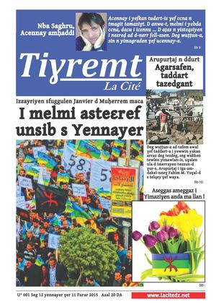
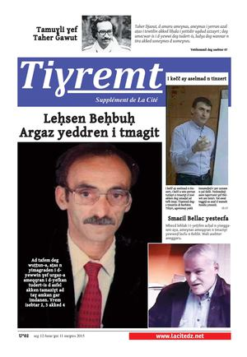
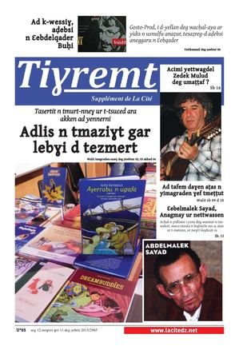
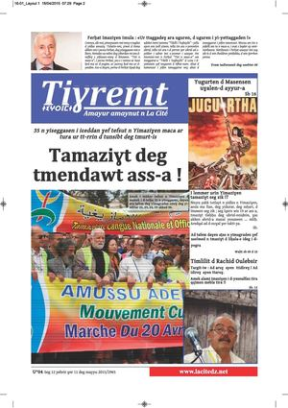
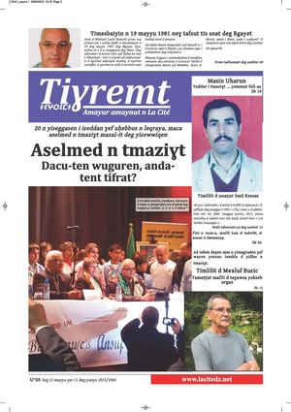
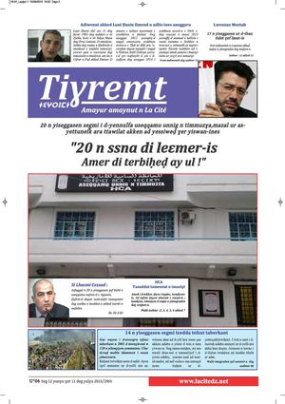
Tisuffiɣin yellan 2015-2016
Uṭṭun 01
Uṭṭun 02
Uṭṭun 03
Seg 12 yennayer ɣer 11 deg furar
Seg 12 furar ɣer 11 deg meɣres
Seg 12 meɣres ɣer 11 deg yebrir
Uṭṭun 04
Uṭṭun 05
Uṭṭun 06
Seg 12 yebrir ɣer 11 deg mayyu
Seg 12 mayyu ɣer 11 deg yunyu
Seg 12 yunyu ɣer 11 deg yulyu

Slide 6
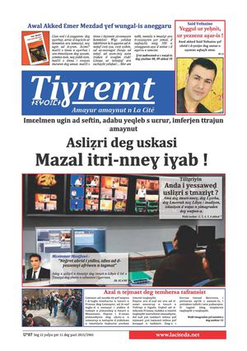
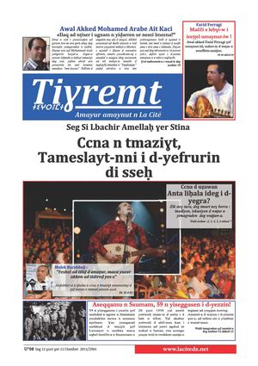
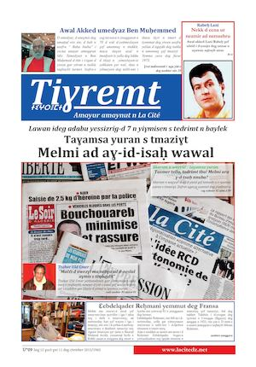
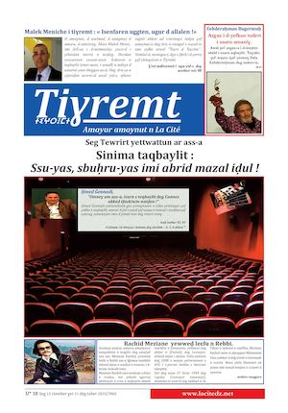
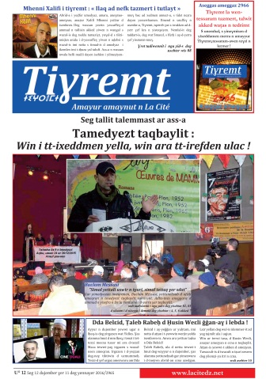
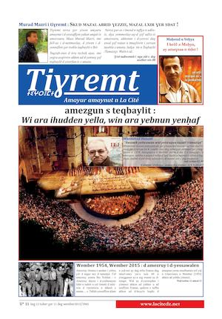
Uṭṭun 07
Uṭṭun 08
Uṭṭun 09
Seg 12 yulyu ɣer 11 deg ɣuct
Seg 12 ɣuct ɣer 11 deg ctember
Seg 12 ctember ɣer 11 deg tuber
Uṭṭun 10
Uṭṭun 12
Seg 12 tuber ɣer 11 deg wember
Uṭṭun 11
Seg 12 dujember ɣer 11 deg yennayer
2016
Seg 12 wember ɣer 11 deg dujember

Slide 7
Bgayet
Aɣiren anda yettnuzu
Bumerdas
Tizi Wezzu
Uṭṭun n tsuffiɣin : 12
Tubiret
Uṭṭun n yisebtar: 16
Amḍan i d-itteffaɣen: 2000
Ineɣmisen imezgiyen: 06
Ssuma-s: 20 DA

Slide 8
Isental igejdanen n yal uṭṭun
U⁰01 : Izzayriyen sfuggulen Janvier d Muḥerrem maca I melmi asteεref unsib s Yennayer ?
Tigejdit: BELǦUDI Malek
U⁰02 : Leḥsen Beḥbuḥ
D argaz yeddren i tmagit.
Tigejdit: HITOUCHE Rachid
U⁰03 : Adlis n tmaziɣt gar lebɣi d tezmert !
Tasertit n tmurt-nneɣ ur t-tsuɛed ara akken ad yennerni.
Tigejdit: HITOUCHE Rachid
U⁰04 : Tamaziɣt deg tmendawt ass-a ?
35 n yiseggasen i iɛeddan ɣef tefsut n Yimaziɣen.
Tigejdit: AIT IGHIL Mohand
U⁰05 : 20 n yiseggasen i iɛeddan ɣef uḥebbus n leqraya, maca aselmed n tmaziɣt mazal-it deg yiɛewwiqen. Dacu-ten wuguren, anda-tent tifrart
Tigejdit: MEKSEM Zahir
U⁰06 : Aseqqamu Unnig n Timmuzɣa : 20 n nnsa di leεmer-is amer di terbiḥeḍ ay ul ! 20 n yiseggasen segmi i d-yennulfa, mazal ar ass-a ur yessiweḍ ɣer yiswan-ines.
Tigejdit: IKHLOUFI Djamal

Slide 9
U⁰07 : Asliẓri deg uskasi. Mazal itri-nneɣ iɣab !
Imɛelmen ugin ad seftin, adabu yeqleb s uɛrur.
Tigejdit: IKHLOUFI Djamal
U⁰08 : Ccna n tmaziɣt, tameslayt-nni i d-yefrurin di sseḥ. Seg Si Lbacir Amellaḥ ɣer Stina
Tigejdit: XALIFI Mhenni
U⁰09 : Taɣamsa yuran s tmaziɣt melmi ad aɣ-id-isaḥ wawal ? Lawan ideg adabu yessizrig-d 7 n yiɣmisen s tedrimt n baylek.
Tigejdit: HITOUCHE Rachid
U⁰10 : Sinima taqbayli: ssu-yas, sbuḥru-yas imi abrid mazal iḍul ! Seg tewrirt yettwattun ar ass-a.
Tigejdit: XALIFI Mhenni
U⁰11 : Amezgun s teqbaylit
Win ara ihudden yella, win ara yebnun yenḥaf
Tigejdit: HITOUCHE Rachid
U⁰ 12 : Tamedyezt taqbaylit
Win i tt-ixeddmen yella, win ara tt-irefden ulac
Tigejdi: AJDAL Muḥemmed

Slide 10
Kra n yimagraden ifazen seg yal uṭṭun
U⁰01 : Tadiwennit akked umaru “Ahmed Hamoum”
Tekcem tmaziɣt agni n tira s tehri. Sbt. 08.
Yesteqsa-t: AIT SLIMANE Hamid
U⁰01 : Sliman Ɛazem.
Tigejdit n ccna n teqbaylit. Sbt. 16.
Sɣur: YAHIOUN Larbi
U⁰02 : Tamuɣli ɣef tudert akked umecwar n Leḥsen Beḥbuḥ. Sbt. 02
Sɣur: ZIDANE Yacine
U⁰03: Tadiwennit akked umaru Mass TAZAƔART Brahim. Lqanun yeqqar amek imdanen xeddmen akken-nniḍen. Sbt. 02-03.
Sɣur: ZIDANE Yacine
U⁰04: Tadiwennit akked umassan Mass RABEHI Allaoua. Tafaska n Udrar n Fad d abrid n usebded n tutlayt. Sbt. 10.
Sɣur: AKOUCHE Nacer
U⁰04: Tadiwennit akked unaẓur Ferḥat Imaziɣen Imula. Tuɣac n wass-a qqarent-d uguren n wass-a . Sbt. 12.
Yesteqsa-t IKHLOUFI Djamel
U⁰05: Tadiwennit akked Massa ABROUS Nacira . Aselmed n tutlayt yerra idles deg rrif, igezzem afriwen i tmetti. Sbt. 2-3.
Yesteqsa-tt: IKHLOUFI Djamel
U⁰05: Tigejdit: aselmed n tmaziɣt.
Yes-s i tedder tmaziɣt, yes-s i d-tewwi izerfan-is. Sbt. 03.
Sɣur: Mass MEKSEM Zahir

Slide 11
U⁰06 : Tadiwennit akked Si Lhachemi Assad, amaray amatu n HCA. Asfuggel n 20 sna s tigawin. Sbt. 02-03.
Yesteqsa-t: HITOUCHE Rachid
U⁰06 : Tiɣremt d tinebgit n temlilit tussnant deg Ribaṭ ( Lmerruk). Sbt. 16.
Sɣur: ZIDANE Yacine
U⁰07 : Tiliẓriyin timaynutin.
Mazal itri-nneɣ iɣab !. Sbt. 02
Sɣur: AT UMALEK Samir
U⁰08: Tizlit tamḥaddit
Ini-yi-d dacu i icennu uɣref ad ak-d-iniɣ amek yettxemmim. Sbt. 06.
Sɣur: AKOUCHE Nacer
U⁰08: Axenzir n tebbuct
D acu-t ? D acu i d aṭṭanen i t-yettḥazen ? Amek ara t-nḥader ? Sbt. 14
Sɣur: Dr DALI Salima
U⁰09: Lqanun amaynut n yissalen
Dacu d amkan i teṭṭef tmaziɣt ? Sbt. 04.
Sɣur : AJDAL Muḥemmed
U⁰09: Taɣamsa yuran s tmaziɣt
Gar tezmert d lebɣi. Sbt. 5-6
Sɣur: CHIKHI Mokrane
U⁰10: Adeg n tmagit deg Ssinima tazzayrit
Aɣref tettwaffer tmagit-is deffir n yisura. Sbt. 05.
Sɣur: AKOUCHE Nacer

Slide 12
Tamlilt n uɣmis deg usnerni n tutlayt.
1- Yettuneḥsab d aɣbalu i tutlayt : deg uɣmis ugtent tsekkiwin d yinawen n yiḍrisen acku ttilint deg-s akk taɣulin i tesra tutlayt, ama d amezruy, tasekla, tamagit, addal, arraten ussnanen;
2- D annar yellan d lbur i tezrawin: imi llan deg-s aṭas n yinawen am tadiwennit, inaw asetran, timiḍranin, timuɣliwin, iberdan n umennuɣ yessuffuɣen;
3- D tamkerḍit n yiḍrisen: acku d iḍrisen iḥeqqaniyen i qerben ɣer tudert n yallas d yidles amaziɣ;
4- D tibḥirt n yisallen: tuget n yimyura semrasen tutlayt timserreḥt iwakken ad ssiwḍen isali ɣer yimeɣriyen, yerna s usḥissef ɣef yisalli;

Slide 13
Awal ɣef yisebtar i d-iteddun deg uɣmis aɣelnaw n yisallen “ La cité ”.
Yetteffaɣ-d uɣmis-a yal ass, llan deg-s 24 n yisebtar s tefransist. Seg useggas 2014 bdan tteffaɣen-d deg-s yisebtar s tmaziɣt deg ussan-a “ acer, ahad, amhad ”. Ass n acer akked ahad teffaɣen-d sin n yisebtar, ma yella ass n amhad ttilin ukuẓ n yisebtar. Seg useggas 2014 ar taggara n useggas 2016 wwḍen 450 n wuṭṭunen teddun-d deg-sen yimagraden yerzan tamirt “ l’actualité”, akked tdiwenniyin yimxalafen.
Hata wamek yella uɣawas-is:

Slide 14
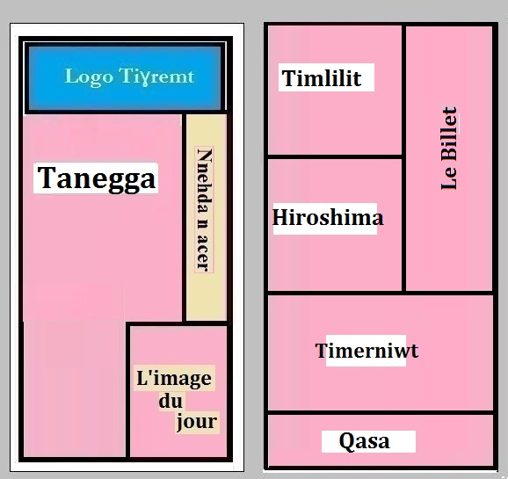

Slide 15
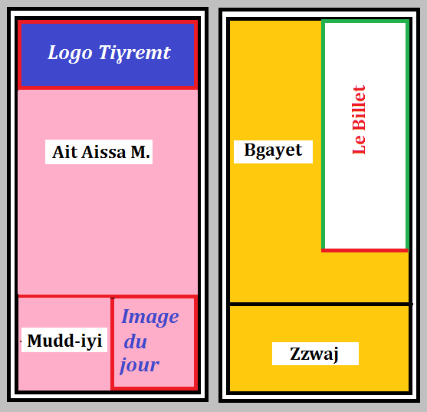

Slide 16
